Slide 1
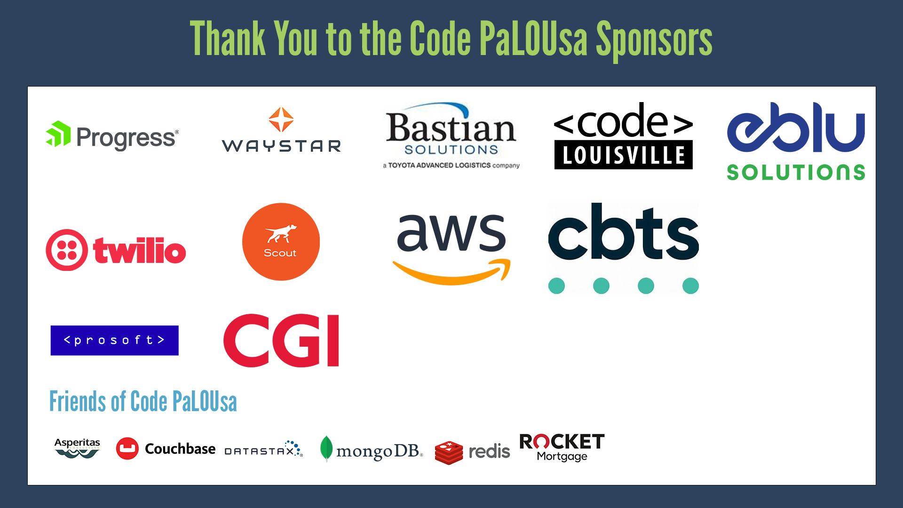

Slide 2
Legacy Relational to Modern NoSQL in Three Steps
Presented by Matthew D. Groves
Notes:
3 steps, doesn't mean they will be fast and easy steps
Also, while it's true that many of our users do switch from relational,
Keep in mind that using NoSQL for a greenfield, when you're used to relational
Requires a shift in thinking, and I hope to address that today too

Slide 3
Are These Your Goals?
Identify a use case that can benefit from a modern database
Get some/all of data on to a modern database
Switch your application / Build a new application
Optimize your data model / access
Notes:
Do I have a use case that can benefit from using NoSQL? User profile, session store, catalog, customer 360, mobile, large scale fintech, etc.
The data you need for that use case is currently in a legacy system like Oracle or SQL Server. It may only be a PORTION of the data in there, not necessarily everything.
Change the application to use NoSQL OR spin out a microservice for just the PORTION
Optimize the data model to meet performance goals

Slide 4
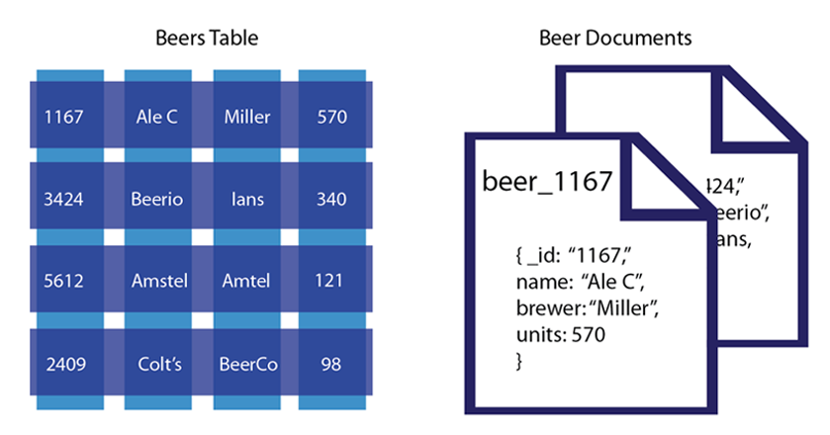
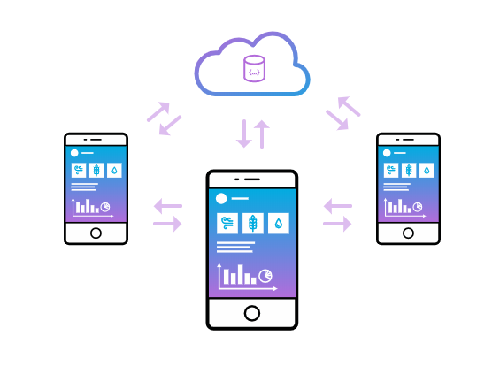
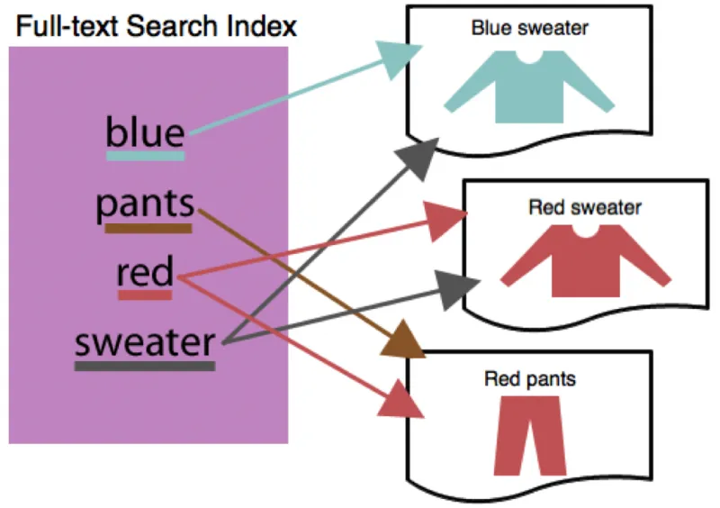
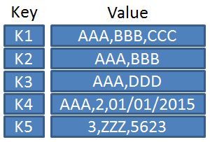
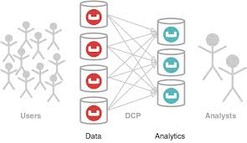
Couchbase: The Modern NoSQL Database
Key-Value Store
Document Database
Edge Database
Search Engine
Analytics HTAP/HOAP
Sub-millisecond performance
Simplicity & Scalability
UC: Caching, Cart, IOT, User Profiles & Sessions
Compare with:
Redis, Elasticache, Aerospike
Flexible JSON schema maps to RDBMS
SQL++ is SQL for JSON
UC: Content Management, Catalog, Metadata, Customer 360
Compare with:
DynamoDB, MongoDB, CosmosDB
Cloud to Edge Sync
Peer to Peer Sync
UC: Field Apps, Airplanes, Ships, Retail Stores, Restaurants, IOT Apps
Compare with:
Realm, SQLite,
Berkeley DB
Full-text Search
Inverted Index
UC: Log analysis, Collaboration, Website Search
Compare with:
Elasticsearch, Solr,
Lucene
No ETL, SQL++, MPP
Workload Isolation
UC: Real-time Insights, Fraud detection, AI, Recommendation engines
Compare with:
MemSQL, CockroachDB, Hana
Notes:
Couchbase Server is a modern, distributed NoSQL database
that fuses the strengths of relational databases (SQL and ACID transactions)
with JSON flexibility and scale.
Databases ARE like languages, it's good to know more than one.
Couchbase is multilingual.
It's a multi-model NoSQL database that supports: documents, key/value, full text search, analytics, mobile,
AND relational style data modeling, as we'll see today.
HTAP = Hybrid transactional/analytical processing (Gartner term), Forrestor calls it "Translytical", 451 Group calls it "Hybrid operational and analytical processing" or HOAP

Slide 5


Who am I?
Matthew D. Groves
Microsoft MVP, author at Pluralsight, Manning, Apress
Product Marketing Manager at Couchbase
https://twitter.com/mgroves
https://www.linkedin.com/in/mgroves/
C# Advent: https://csadvent.christmas/
Notes:
I'm a Microsoft MVP, and I'm also an author with Pluralsight, Manning, and Apress
I work for Couchbase in marketing, you might be surprised to see a marketing title in a technical talk
But Couchbase is a database, used by developers and technical people
So I think it makes sense to have developers / technical people in marketing
Couchbase, by the way, is a NoSQL database, but it's interesting to bring up in this session because
It has a built-in managed cache. Later, we'll see why that's useful and makes your life easier
You can contact me on Twitter or LinkedIn!
I also run an annual event called the C# Advent. If you are into C#, you should check it out because it will be starting up soon

Slide 6
Agenda
01/
Mapping from relational
02/
Shift Application Code
03/
Optimize

Slide 7
Mapping from relational
1

Slide 8
Why now?
Couchbase Capella
Scopes / collections
ACID Transactions
SQL++ (née N1QL)
Notes:
The features in Couchbase 7 make it easier than ever, and Couchbase Capella makes it easy to bring to the cloud with a fully managed DBaaS
Scopes/collections provide organizational building blogs akin to schemas/tables
ACID transactions means that you can fall back to relational-style modeling when you need to
SQL++ has been around long before Couchbase 7, but it continues to mature, include richer functionality like UDFs, and even has a BEGIN/COMMIT/ROLLBACK itself
But SELECT/INSERT/UPDATE/DELETE/MERGE, CTEs, JOINs, aggregations, those are all there too and have been battle tested for a while

Slide 9
So, is NoSQL just relational database now?
Distributed
Highly available
Flexible
Memory-first
Notes:
You might ask, has Couchbase just reinvented a relational database?
I would say that Couchbase has become a fusion of the best of both worlds.
It can do relational-style things now, yes. But the core focus on Couchbase still includes all these things.
Our goal is not to reinvent, but to push the boundaries and support the needs of your modern app development.

Slide 10
SQL-to-Couchbase Dictionary
Legacy (relational) | Modern (Couchbase) | Notes
Server | Cluster | ➕ Scalability / High Availability
Database | Bucket | ➕ Replication / Caching
Schema | Scope | "dbo" and "_default"
Table | Collection | ➕ Flexibility
Row | Document | ➕ JSON
tSQL (SQL) | SQL++ | Full SQL implementation with: SELECT, JOIN, COMMIT, ROLLBACK, GROUP BY, INSERT, etc…
Primary Key | Document Key
Index | Index

Slide 11
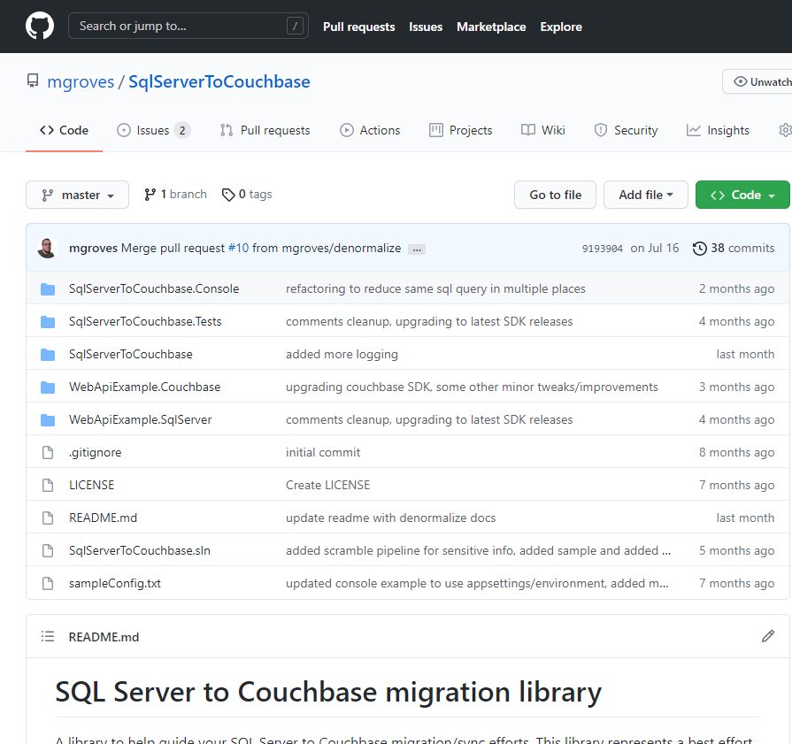
SqlToCouchbase Library
Notes:
I'm working on a SqlServerToCouchbase Library, a .NET library to help developers move from SQL Server to Couchbase, specifically
Even if you don't use .NET or SQL Server, the same principles still apply to any relational database

Slide 12
Other Options/Tools
Dataworkz - https://dataworkz.com/
Real-time sync and model refactoring
GlueSync - https://gluesync.com/
Real-time sync between NoSQL and SQL Server / Oracle
Especially good for mobile
Couchgres - https://github.com/metonymic-smokey/couchgres
Open source community project
Migrate from Postgres to Couchbase
Python script - https://bit.ly/mysqlPython
Bare-bones, script-based approach
Import CSV via UI
Notes:
These are some other tools that take a similar approaches.
Anywhere from a full commercially supported tool, to an open source project, to a DIY set of scripts
My project is most similar to Couchgres, and we've even collaborated a bit ☺

Slide 13
Demo: Mapping
Notes:
Show SQL Server, AdventureWorks
Go over database/schema/table
Show SQL query on Address table
Show SQLServerToCouchbase utility (appsettings.json)
Do it in Capella ahead of time
Go to bucket, show scopes, show collections
Go into address
Show a document in address
No modeling changes, just a "lift and shift"
Run a SQL query:
SELECT *
FROM AdventureWorks2016.Person.Address a
WHERE a.AddressID IS NOT MISSING
LIMIT 10;

Slide 14
Shift Application Code
2
Notes:
And speaking of SQL and N1QL queries, let's move to step 2
Moving the database over is an important step, but there's also the application code
That connects, reads, and writes from the database.
If you're spinning off a new service, no problem, you don't necessarily have an application to shift
But if you're spinning off part or all of an application, you'll need to make changes to the parts that used the relational database
(And by the way, this is the hardest, most time-consuming, but arguably the most fun part)
So I just want to reiterate, make sure you have good reasons before you do this.

Slide 15
What do I need to shift?
SDK – connecting to the database
SQL – querying the database
ACID Transactions – updating data reliably
Notes:
SDK – whatever language your software is written with uses an SDK to connect to a database.
Couchbase has officially supported SDKs for 10 languages, including Java, Node, Ruby, .NET, C, and so on
SQL – if you're refactoring an existing application, much of it that interacts with the database may consist of SQL queries that your team has written over the years. Do we have to rewrite all of that? The answer from many of our competitors is "yes", our answer is "you can use and maybe reuse existing SQL"
ACID – for a long time, this has been an Achilles heel of distributed databases, no ACID transaction support. But Couchbase now has it.

Slide 16
SQL: Reuse
Official Microsoft example of tSQL
SELECT RTRIM(p.FirstName) + ' ' + LTRIM(p.LastName) AS Name, d.City
FROM AdventureWorks2016.Person.Person AS p
INNER JOIN AdventureWorks2016.HumanResources.Employee e
ON p.BusinessEntityID = e.BusinessEntityID
INNER JOIN
(SELECT bea.BusinessEntityID, a.City
FROM AdventureWorks2016.Person.Address AS a
INNER JOIN AdventureWorks2016.Person.BusinessEntityAddress AS bea
ON a.AddressID = bea.AddressID) AS d
ON p.BusinessEntityID = d.BusinessEntityID
ORDER BY p.LastName, p.FirstName;
Notes:
If you're moving an app to a modern database, it's a lot of work
So let's look for reuse wherever we can.
If it's a Java app using the Spring framework, look for a Spring connector, for instance.
But let's say we have a bunch of SQL queries, what do we do?
One thing that sets Couchbase apart from other document databases
Is that Couchbase has supported SQL for many years
So, if you are already using SQL queries in your applications, this won't change much
And that will make the transition smoother
Many databases claim a "sql-like" language, but SQL++ is on a whole other level.
For instance, this query here is from official Microsoft documentation about tSQL, the SQL Server implementation of SQL
It returns all employees and the cities they live in.
It's a non-trivial example of SQL: there are multiple joins, a subquery, ordering, multiple tables, multiple schemas, string functions, concatenation

Slide 17
SQL: Reuse
SQL++ version of the same query (after converting data into Couchbase)
SELECT RTRIM(p.FirstName) || ' ' || LTRIM(p.LastName) AS Name, d.City
FROM AdventureWorks2016.Person.Person AS p
INNER JOIN AdventureWorks2016.HumanResources.Employee e
ON p.BusinessEntityID = e.BusinessEntityID
INNER JOIN
(SELECT bea.BusinessEntityID, a.City
FROM AdventureWorks2016.Person.Address AS a
INNER JOIN AdventureWorks2016.Person.BusinessEntityAddress AS bea
ON a.AddressID = bea.AddressID) AS d
ON p.BusinessEntityID = d.BusinessEntityID
ORDER BY p.LastName, p.FirstName;
Notes:
This is the same query converted over for use in Couchbase
It returns the same results.
There is a slight difference in syntax? Can you tell what it is?
The only thing that's different is the concatenation operation; for Couchbase it's double pipe instead of plus
It won't always be this easy of course, but you get a pretty good head start towards modernization,
Using a language that most developers in your organization already know: SQL.

Slide 18
ACID Transactions: relational
C# example – SQL Server
public async Task<IActionResult> UpdatePurchaseOrderAsync(PersonUpdateApi personUpdateApi)
{
var transaction = await _context.Database.BeginTransactionAsync();
try
{
// update one or more rows of data, save changes
await _context.SaveChangesAsync();
// commit transaction
await transaction.CommitAsync();
return Ok($"Person {personUpdateApi.PersonId} name and email updated.");
}
catch (Exception ex)
{
// rollback transaction
await transaction.RollbackAsync();
return BadRequest("Something went wrong, transaction rolled back");
}
}
Notes:
This is a how a transaction looks in C# when using Entity Framework
I've left out the actual data manipulation code so it fits on the slide
If you don't know C#, that's fine, just note that there are three main steps
To using a transaction from an application
[animate the red squares]
Begin: start a transaction – every data operation in that transaction becomes part of an all-or-nothing operation
Commit: transaction is done – data is committed and operation is done
Rollback: rewind -- if something goes wrong within the transaction, then roll it back as if it has never happened

Slide 19
ACID Transactions: Couchbase
C# Example – Couchbase Server
public async Task<IActionResult> UpdatePurchaseOrderAsync(PersonUpdateApi personUpdateApi)
{
// create transaction
var transaction = Transactions.Create(cluster,
TransactionConfigBuilder.Create().DurabilityLevel(DurabilityLevel.None).Build());
try
{
await transaction.RunAsync(async (context) =>
{
// update one or more documents, save changes
// commit (implied)
});
return Ok($"Person {personUpdateApi.PersonId} name and email updated.");
}
catch (Exception ex)
{
// rollback (implied)
return BadRequest("Something went wrong, transaction rolled back.");
}
}
Notes:
Here's how a transaction looks in C# when using Couchbase
Again, I've left out the data manipulation code so it fits on the slide
But there are the same three parts
Begin: create a transactions object – there are some different settings to think about since this is distributed, but there are sensible defaults
Commit: notice that in C#, the transaction uses a lambda function; everything within the lambda is in a transaction automatically. This is true in Java as well. So the "commit" doesn't have to be explicit, it just happens when the lambda ends
Rollback: rollback is also implied; if there's an exception inside the lambda. You can also call rollback and lambda explicitly, if you need to for more complex scenarios
But it's the same three steps either way. Developers don't need to create their own transaction framework or workaround ACID limitations anymore.
So what does this all mean? It's not going to be an overnight process to modernize.
But with Couchbase, it's going to be weeks or a few months instead of years and years.

Slide 20
Demo: Shifting App
Notes:
Back to SQLServerToCouchbase demo
ASP.NET
Show the SQL Server version endpoint GetPersonByIdRawAsync
Show the Couchbase version of GetPersonByIdRawAsync
Show the SQL Server ACID example: UpdatePersonAsync
Show the PersonUpdateApi class
Show the Couchbase ACID example: UpdatePersonAsync

Slide 21
Optimize
3

Slide 22
Consolidate
Relational-style data is spread out
Requires JOINs and/or ACID transactions (overhead)
De-normalize

Slide 23
Many-to-One consolidation
Person has 1 or more EmailAddress
{
"PersonID": 123,
"FirstName": "Ken",
"MiddleName": "J",
"LastName": "Sánchez",
"ModifiedDate": "2009-01-07T00:00:00"
}
{
"PersonID": 123,
"EmailAddress": "ken0@adventureworks.com",
"ModifiedDate": "2009-01-18T04:23:07"
}
{
"PersonID": 123,
"FirstName": "Ken",
"MiddleName": "J",
"LastName": "Sánchez",
"ModifiedDate": "2009-01-07T00:00:00",
"EmailAddresses": [
{
"PersonID": 123,
"EmailAddress": "ken0@adventureworks.com",
"ModifiedDate": "2009-01-18T04:23:07"
}
]
}
Notes:
When I copy data directly from relational to Couchbase
It stays in this relational-style format
Person is a single document.
Person can have multiple email addresses
Each email address has its own document
I don't have to keep it this way. In fact, keeping it this way
Can be a performance detriment. Now I need to use a JOIN
When I want to SELECT a person and their email addresses
And I may have to use an ACID transaction when updating both at the same time
You CAN do this. BUT you may want to consolidate
Which can help you meet your performance goals.
In my utility, you can specify which tables should be combined
And the end result would look like this
[click to reveal]
Now there's a single, consolidated person document.
You no longer have to use a JOIN. You no longer have to use SQL++, even
To get this single piece of data (more on that in a second).
And you don't need an ACID transaction to update.
So, if your application has millions of users, who often update their profile
And/or their email address, you've just improved performance with one simple
Data model refactor.

Slide 24
One-to-One consolidation
PhoneNumber has a PhoneNumberType
{
"PhoneNumberID": 10000,
"PhoneNumber": "388-555-0157",
"PhoneNumberTypeID": 1,
"ModifiedDate": "2013-11-09T00:00:00",
"PhoneNumberType_PhoneNumberTypeID": 1,
"PhoneNumberType_Name": "Cell",
"PhoneNumberType_ModifiedDate": "2017-12…"
}
{
"PhoneNumberID": 10000,
"PhoneNumber": "388-555-0157",
"PhoneNumberTypeID": 1,
"ModifiedDate": "2013-11-09T00:00:00"
}
{
"PhoneNumberTypeID": 1,
"Name": "Cell",
"ModifiedDate": "2017-12-13T13:19:22.273"
}
Notes:
Similarly, one-to-one mappings can work the same way.
In the original relational model, there was data for phone numbers and separate data for phone number type
Again, with the utility I wrote, you can specific which collections get combined.
[click to reveal]
And now, there's a single "phone number" record, with the type information embedded
No need to JOIN to get that information anymore
You should think carefully about this. If you add/modify/delete phone number types, you'll need to update all phone records. But maybe that happens so rarely that it's worth the performance improvements.

Slide 25
Use the key-value API when possible
The key-value API is always faster
SELECT p.*
FROM AdventureWorks2016.Person.Person p
WHERE p.PersonID = 123
var person = await coll.GetAsync("123");
Notes:
With relational databases, SQL is the ONLY way to interact with data
Couchbase also has a key-value API
And the key-value lookup is always the fastest way to retrieve a single piece of data
So, if your application has a SQL query that's looking up a single piece of data by
Its ID, replacing that with a key-value lookup is going to improve performance,
Reduce latency, and reduce pressure on the query service
That's a C# example on the right, but very similar APIs are available for all
Of the Couchbase supported SDKs (java, node, php, python, and so on)
Again you CAN keep the version of the left if you want, but the version on the right
Is better.

Slide 26
Demo: Refactoring
Notes:
Show DenormalizeMaps in appsettings.json
ManyToOne mapping (email to person)
Show it in Couchbase Capella (done ahead of time)
Look in Person Scope, then Person Collection, look at a document
Note "vestigial" data

Slide 27
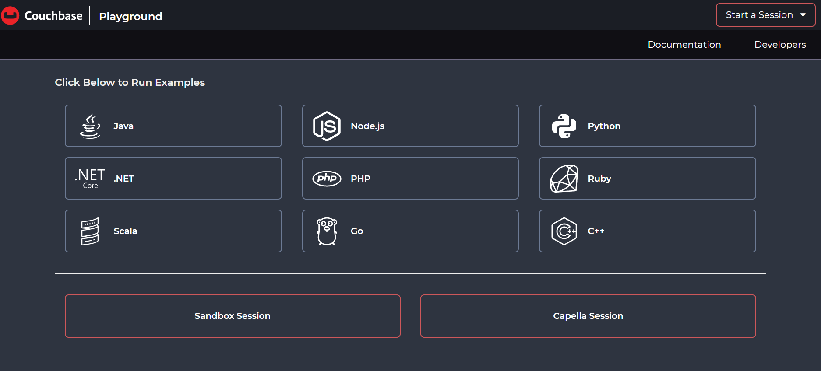
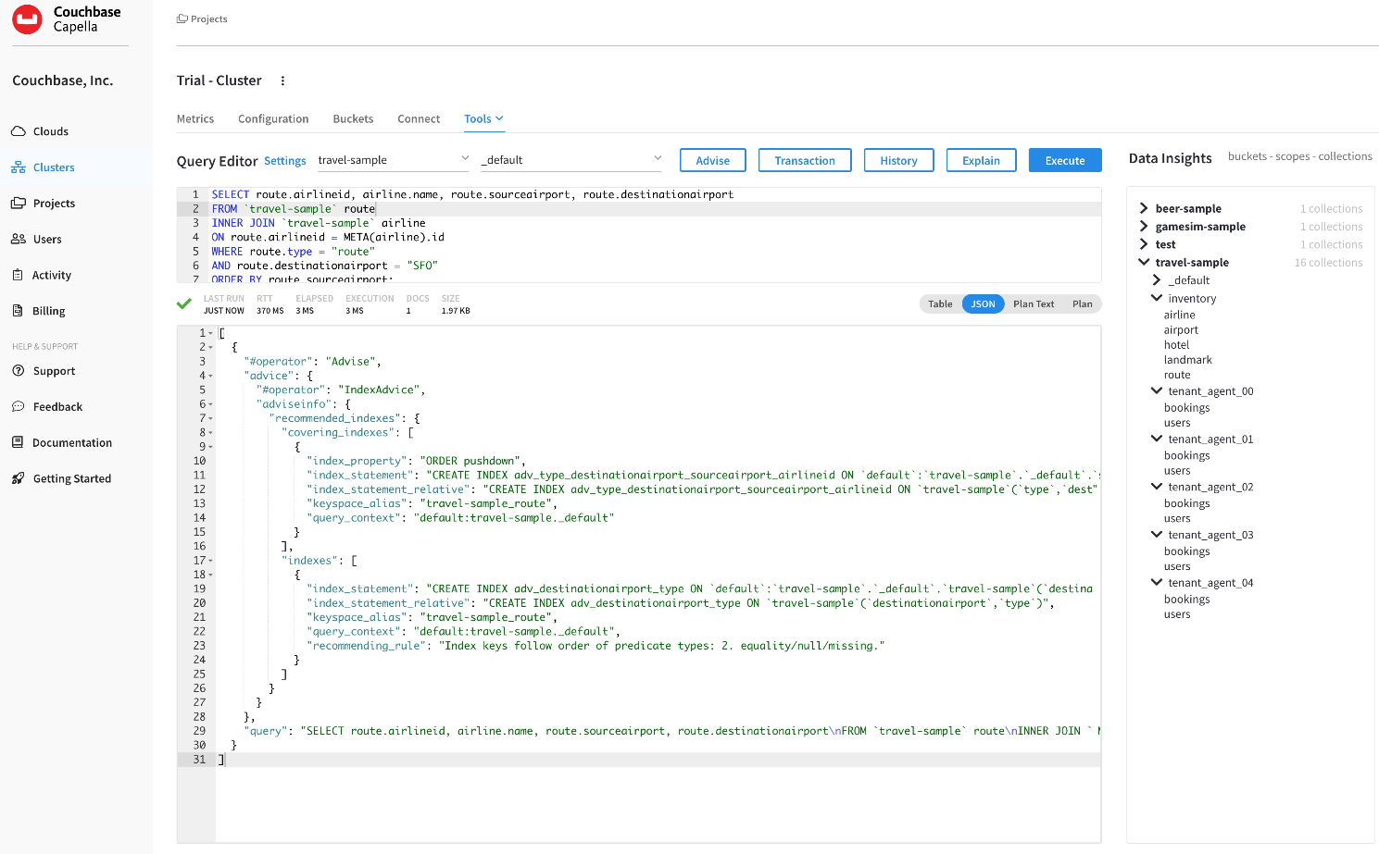
Next Steps
Couchbase Playground: 30 min session
https://couchbase.live/
Examples and learning path
Connect to the Capella trial
Couchbase Capella Trial: 30 days
https://cloud.couchbase.com/sign-up
Self service tutorial
Sample data / import data
Post trial options
Sign up with pay-as-you-go model
Starter Kits: Discounted credits & professional services

Slide 28
CONTACT
Matthew Groves
https://github.com/mgroves/SqlServerToCouchbase

